Slide 1

Thursday 22nd February meeting
Small meeting
Notes:
Welcome to the Thursday meeting. We have a few things to discuss.

Slide 2
How is everyone doing?
Discuss
Notes:
How is everyone doing?

Slide 3
The attack on the University’s servers
Don’t worry
Looks like we’re way ahead
Proceed with the tasks (or try to)
Seems like we should have another week added (possibly)
Notes:
About the attack on the University’s servers, don’t worry about it. It looks like we’re way ahead from what the workshop tutor said. However, please proceed with your tasks or try to as I know it has affected a lot of things that you were working on unfortunately. But it does seem like we’re having another week on the sprint. I’m not sure though.

Slide 4
Workshop
The workshop tutor actually likes us compared to the other groups (I believe)
No worries there.
Notes:
And about the workshops, from what it looks, the tutor likes us compared to the other groups. It is actually funny. But no worries there. We shall proceed as planned.

Slide 5
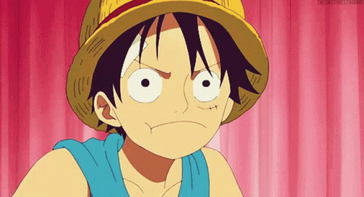
Any questions?
Notes:
Any questions?

